Slide 1
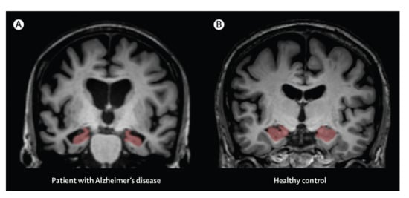
MRI and Alzheimer's
Monica Cortez

Slide 2
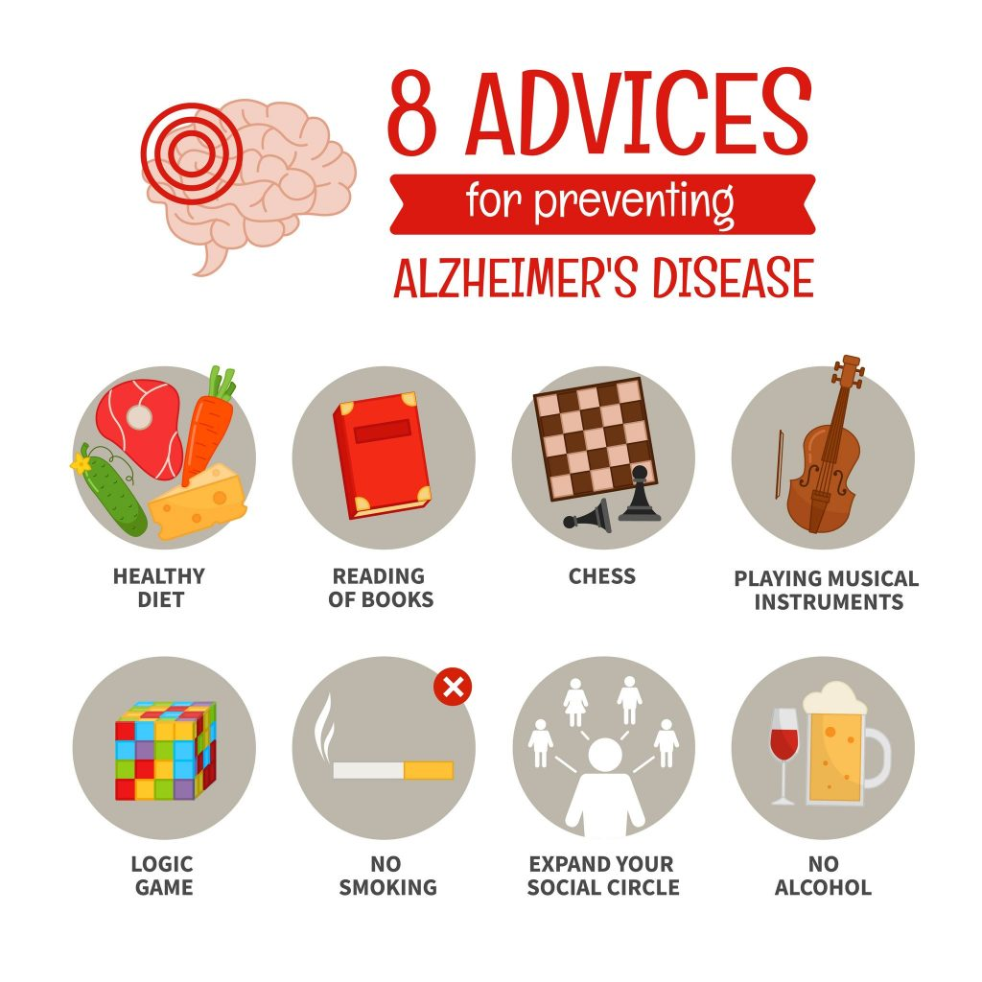
Alzheimer's and Early Detection
MRI data is made widely available in order to aid discoveries in the neuroscience.
Alzheimer's is a degenerative disease and is often diagnosed and treated in its late stages.
Early detection helps with distribution of medications, change in lifestyle, and improvement of health markers.

Slide 3
Dataset
Open Access Series of Imaging Studies (OASIS)
13 kB
Cross-sectional MRI Data in Young, Middle Aged, Nondemented and Demented Older Adults
416 subjects aged 18 to 96.
each subject, 3 or 4 individual T1-weighted MRI scans obtained in single scan sessions are included
Longitudinal MRI Data in Nondemented and Demented Older Adult
150 subjects aged 60 to 96
each subject, 3 or 4 individual T1-weighted MRI scans obtained in single scan sessions

Slide 4
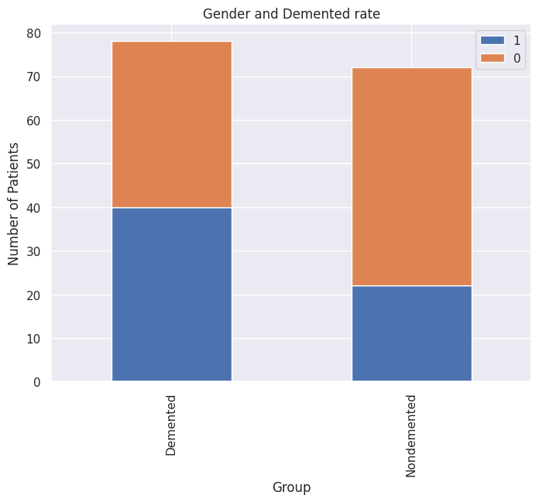
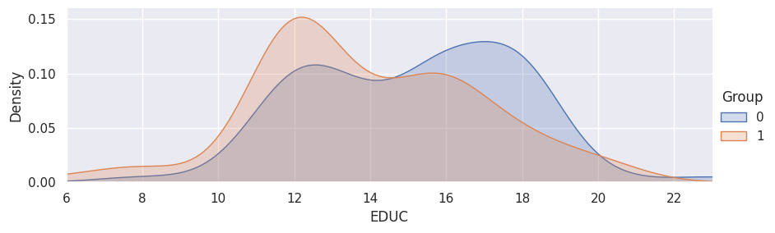
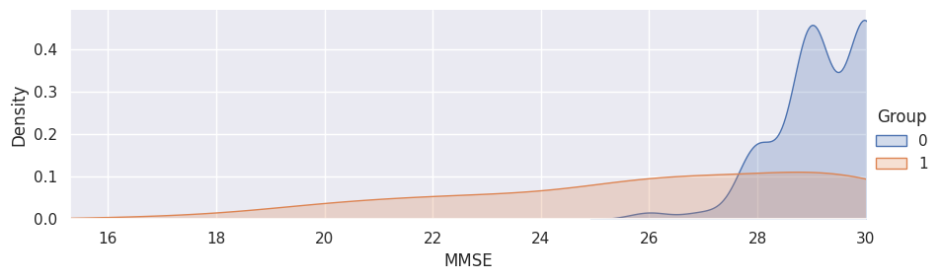
Exploratory data analysis
0 is female, 1 is male
0 is nondemented, 1 demented

Slide 5
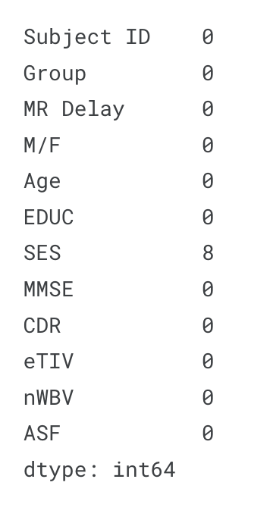
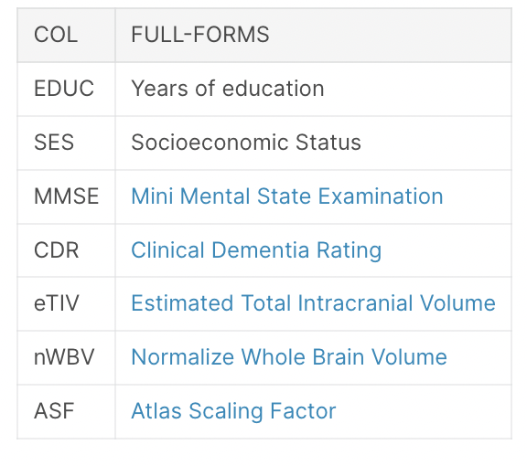
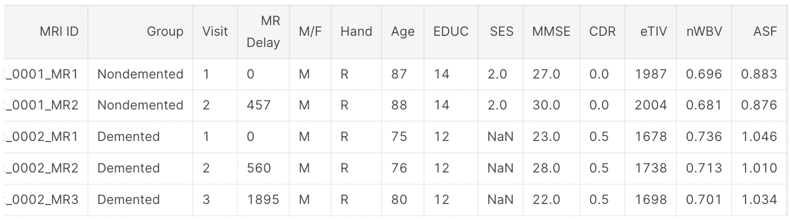
Data cleaning and preprocessing
Removed handedness
Only using information from first visit
Change converted into demented
Removed MRI ID

Slide 6
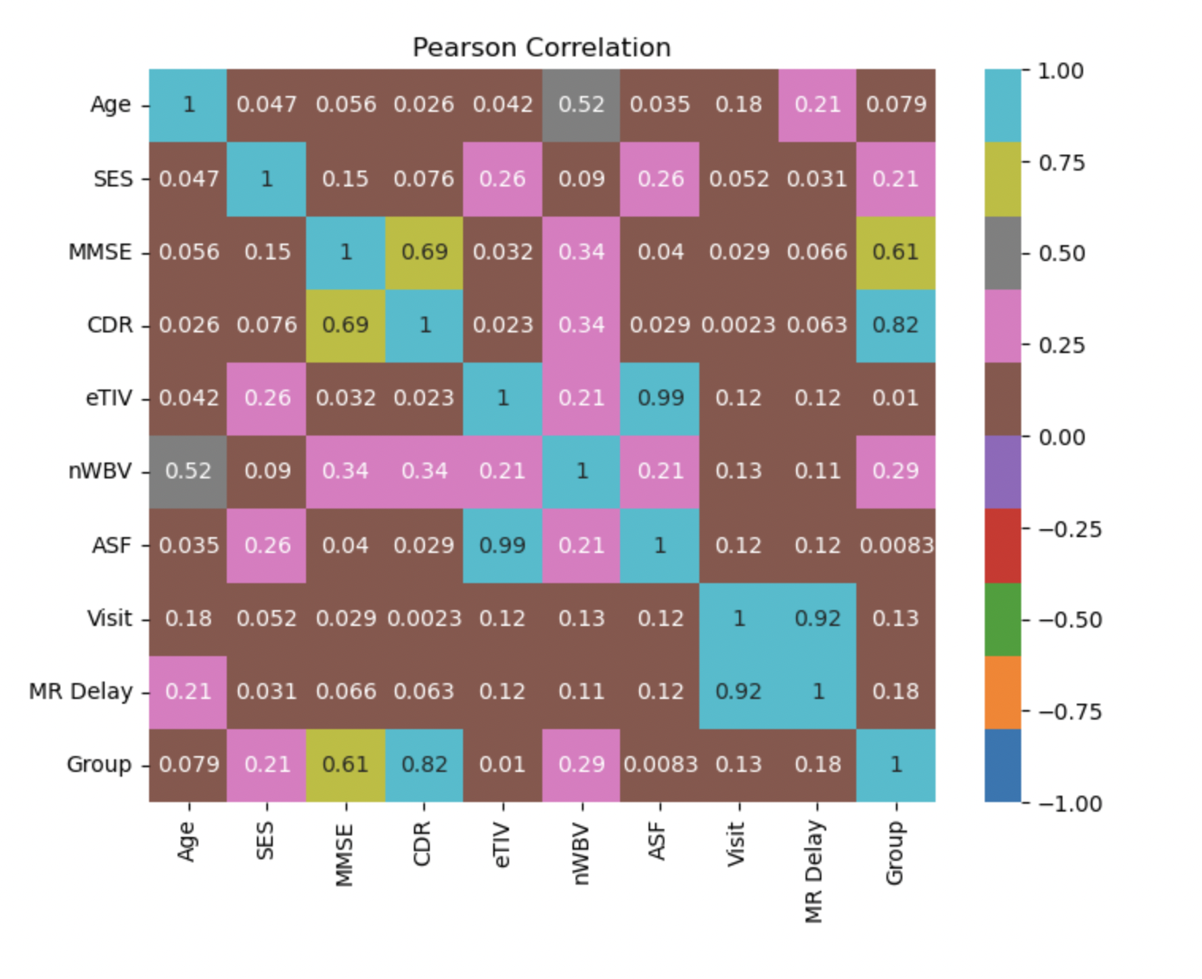
Correlations
Strong correlations between different measures of volumes, dementia ratings, groups, healthy brain tissue analysis
Notes:
Dataset didn’t need much data engineering as OASIS sets it up that way

Slide 7
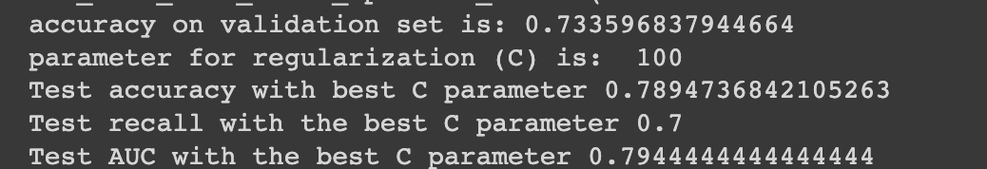
Logistic Regression

Slide 8
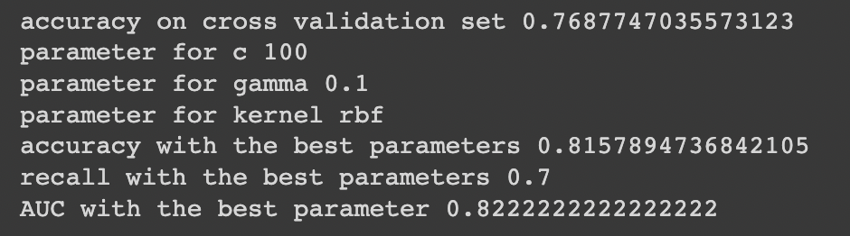
SVM

Slide 9
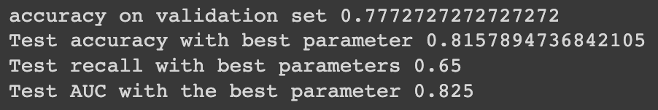
Decision Tree
Notes:
MMSE was the most important, gini=

Slide 10
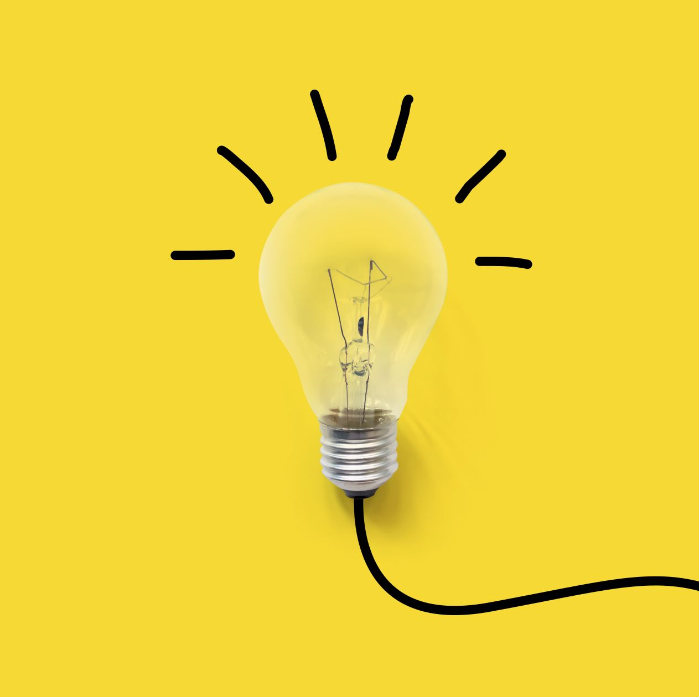
Challenges and Future direction
The accuracy of these models
Computational power
Expertise
Complexity
Using CNN
Merging different datasets

Slide 11

End to End Learning

Slide 12
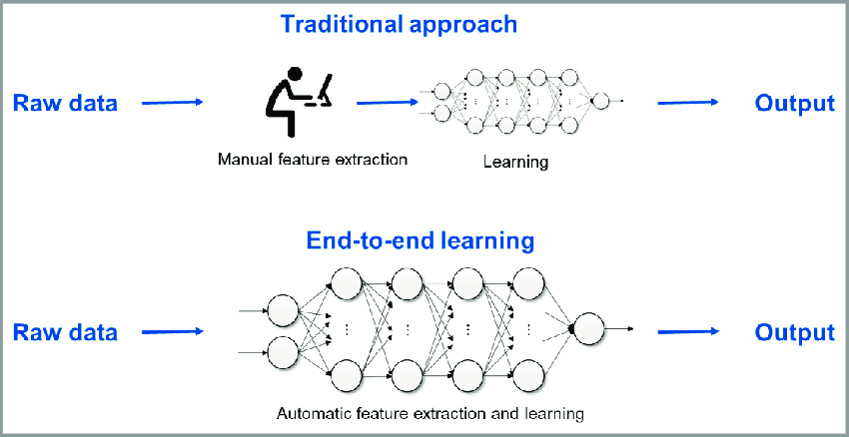
What is End to End Learning?
Technique where the model learns all the steps between the initial input phase and the final output result.
This is a deep learning process where all of the different parts are simultaneously trained instead of sequentially.
Notes:
End-to-end learning refers to training a possibly complex learning system by applying gradient-based learning to the system as a whole. End-to-end learning system is specifically designed so that all modules are differentiable.

Slide 13
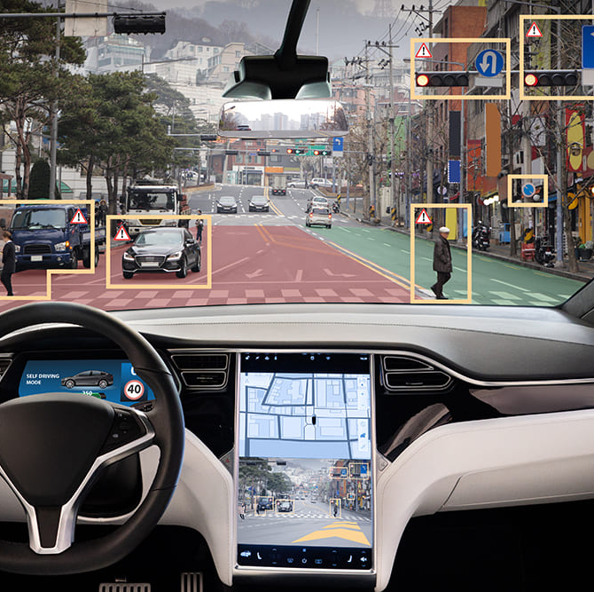
Uses of End to End Learning
Creation of a written transcript (output) from a recorded audio clip (input).
Self-driving cars. Their systems are trained to automatically learn and process information using a CNN. In this case, systems use previously provided human input as guidance to complete tasks.
Notes:
end-to-end learning does not make optimal use of the modular design of present neural networks.

